Slide 1
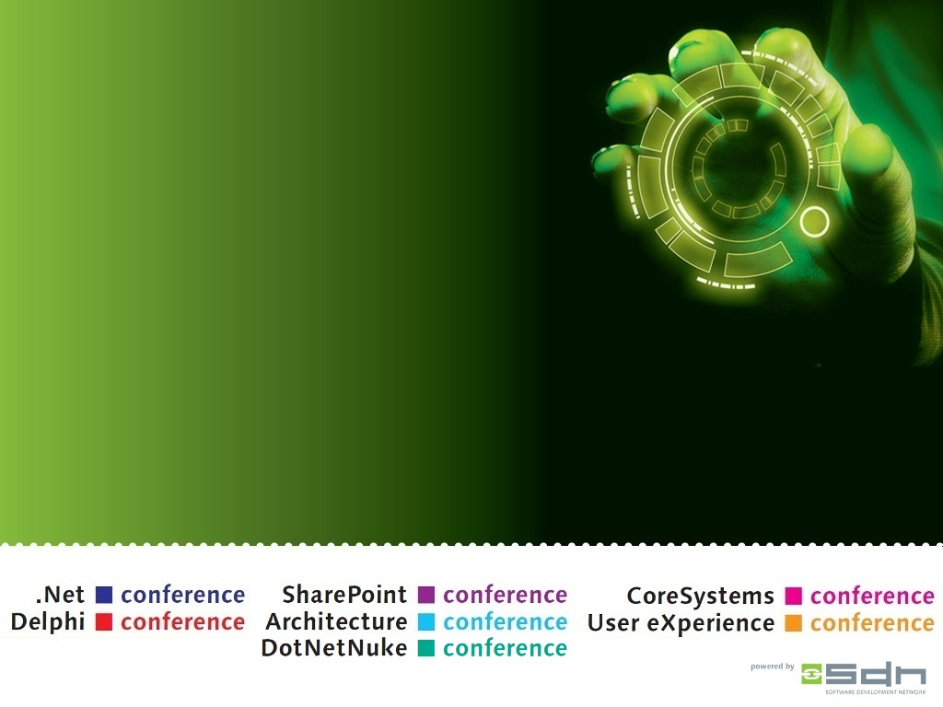
The Art of Unit Testing DotNetNuke Extensions
Ian Robinson
R2integrated
Session Code: NN04

Slide 2
Ian Robinson
@irobinson
irobinson@r2integrated.com
http://dnnGallery.net
http://r2idnn.com

Slide 3
Questions Answered
What is Unit Testing?
Why do I care?
What does it look like?
How can I unit test in DNN?
What tools do I use?
Can I see some codez please?
Notes:
Session Overview:
Are you interested in creating better DotNetNuke extensions faster? Unit testing your DotNetNuke extensions (e.g. a module or provider) can help you achieve high quality software more quickly. The practice of unit testing allows one to discover defects earlier and write code that is easier to maintain over the long term. This session will provide an invaluable overview of the practice of unit testing within the DotNetNuke framework with examples using the open source unit-testing framework mbUnit.

Slide 4
Why are we here?
To write better software
Cheaper, Better, Faster
Longer term / holistic view

Slide 5
Unit Testing Benefits ^{[1]}
Facilitates Change
Simplifies integration
Provides Documentation
Design
[1] http://en.wikipedia.org/wiki/Unit_testing
Notes:
Define unit testing and talk about why we’re here talking about unit testing. Why is it a desirable practice in software development? What benefits does it have? Why do we want to incorporate it into DotNetNuke?
Try to put it in practical terms.
Logical errors – most obvious – you want to know if you’re code is wrong.
Perspective? You’re the consumer of what you write. This has some interesting (and positive) implications.
Prove the logic
Discover errors
Get a different perspective and think critically about your code
Force your code into conciseness

Slide 6
What do unit tests test?
Smallest piece of testable software^{[3]}
Logical and/or complex code
Core business logic
High traffic code / mission critical
Or, in TDD: everything!
[3] http://msdn.microsoft.com/en-us/library/aa292197.aspx
Notes:
The primary goal of unit testing is to take the smallest piece of testable software in the application, isolate it from the remainder of the code, and determine whether it behaves exactly as you expect.

Slide 7
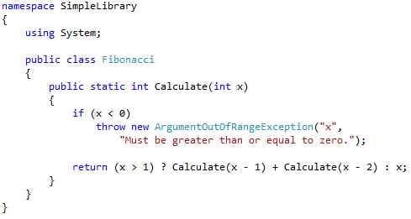
Simple Code

Slide 8
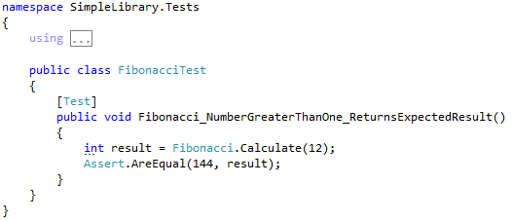
Simple Test

Slide 9

Unit Test Characteristics
Unit tests should be: ^{[2]}
Automated & Repeatable
Easy to implement
Once written, it remains for future use
Anyone should be able to run it
It should run at the push of a button
Run quickly
[2] The Art of Unit Testing, Roy Osherove, Manning Publications 2009
Notes:
Introduce the book and use it to frame the conversation regarding the characteristics of unit tests. Let the audience know what type of additional information can be found in the book.

Slide 10
Testing Frameworks
Unit Testing “Glue”
  (Addresses the Automated & Repeatable)
csUnit, MbUnit, MSTest, Nunit, xUnit
Pick one and go

Slide 11
MBUnit
Class and Method Attributes
Assertions

Slide 12
Gallio
Test Runner
  Also displays results
Visual Studio Integration
ReSharper Integration

Slide 13
What is testable code?
Is all code testable?
Single Responsibility/Separation of Concerns
Dealing with dependencies
Notes:
Need links to resources

Slide 14
Seams
“…place where you can alter behavior of your program without editing it in that place” – (Feathers, 2005)
Plug-in / Injection

Slide 15
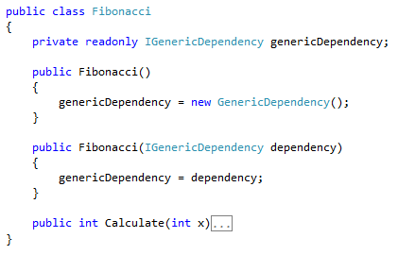
Seam / Constructor Injection

Slide 16
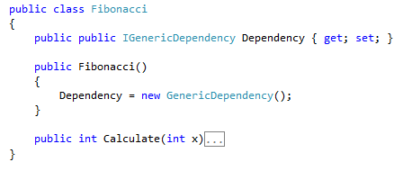
Seam / Property Injection

Slide 17
Two Consumers
Production Code
Tests
Seams help cater to the test

Slide 18
Fakes!
Stubs
  Return results
  Throw exceptions
Mocks
  Verify behavior

Slide 19
Isolation Frameworks
Help us create fakes
And verify expectations
Moq, Nmock, Rhino Mocks, Typemock Isolator

Slide 20
My Setup
MBUnit – Unit testing framework
MOQ – Isolation framework
Gallio – Test runner
  Integrated into Visual Studio / Resharper
Notes:
Need to explain tools in general, and then these in particular.

Slide 21
Testable Code & ASP.NET
ASP.NET Frameworks
  ASP.NET MVC
  WebForms
DotNetNuke (based on WebForms)
  WebFormsMVP

Slide 22
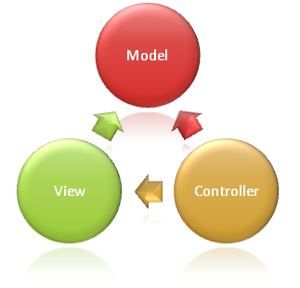
ASP.NET MVC
Test friendly? Yep.
Naturally separates business logic
[4] http://seekdotnethosting.wordpress.com/2009/09/01/asp-net-mvc-hosting-asp-net-frameworks-and-structure/

Slide 23
Web Forms
Is web forms less testable?
  Probably safe to say yes.
Doesn’t explicitly enforce structure

Slide 24
WebFormsMVP
Separation of concerns
Increased Testability
“Cleaner Architecture”
Retains basic characteristics of WebForms

Slide 25
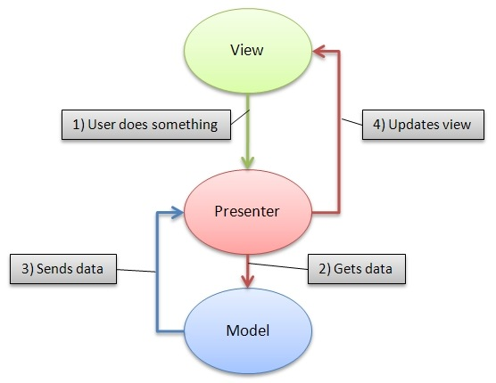
WebFormsMVP

Slide 26
WebFormsMVP Characteristics
Requires the view to give control to Presenter
The view and presenter pass around a model
Interfaces used for testability

Slide 27
WebFormsMVP in DNN
Introduced in Version 5.3
WebFormsMVP.dll bundled
Thin layer on top to provide context

Slide 28
WebFormsMVP in DNN
View
  ModuleView
  IModuleView
Model
Presenter
  ModulePresenter base class

Slide 29
The View
[PresenterBinding(typeof(UserListPresenter))]
public partial class UserList : ModuleView<UserListModel>, IUserList
{
}
Notes:
Presenter based discovery strategy

Slide 30
The View Interface
public interface IViewUserList : IModuleView<UserListModel>
{
}
// place where we wire up events
Notes:
So, why do we have an empty view?
We’re doing this for testability
We get stuff from IModuleView!
Events will go here…(show an example)

Slide 31
The Model
public class UserListModel()
{
Public List<UserInfo> Users {get;set;}
}

Slide 32
The Presenter
public class UserListPresenter : ModulePresenter<IViewUserList, UserListModel>

Slide 33
Real World DNN Tests
DotNetNuke Core Tests
Vocabulary & Messaging Modules
DotNetNuke_Community_UnitTests.sln
Notes:
Find a relatively simple example from the DotNetNuke core to demonstrate the characteristics of unit tests.

Slide 34
BeerCollectionMVP
C#
WebFormsMVP
DotNetNuke Module
Web Application Project
Visual Studio 2010
MOQ & MbUnit
http://github.com/irobinson

Slide 35
Key Take-Aways
Unit testing increases confidence in your code. Code is more changeable.
Therefore Unit Testing is a desirable practice
WebFormsMVP allows us to better conduct unit testing in DotNetNuke

Slide 36
Recommended Resources
Unit Testing
  The Art of Unit Testing by Roy Osherove
  Working with Legacy Code by Michael Feathers
WebFormsMVP
  Podcast: Hanselminutes Episode 202
  http://webformsmvp.com

Slide 37
Evaluation form
Vul je evaluatieformulier in en maak kans op een van de prachtige prijzen!!
Fill out your evaluation form and win one of the great prizes!!
Session Code: NN04

